Slide 1
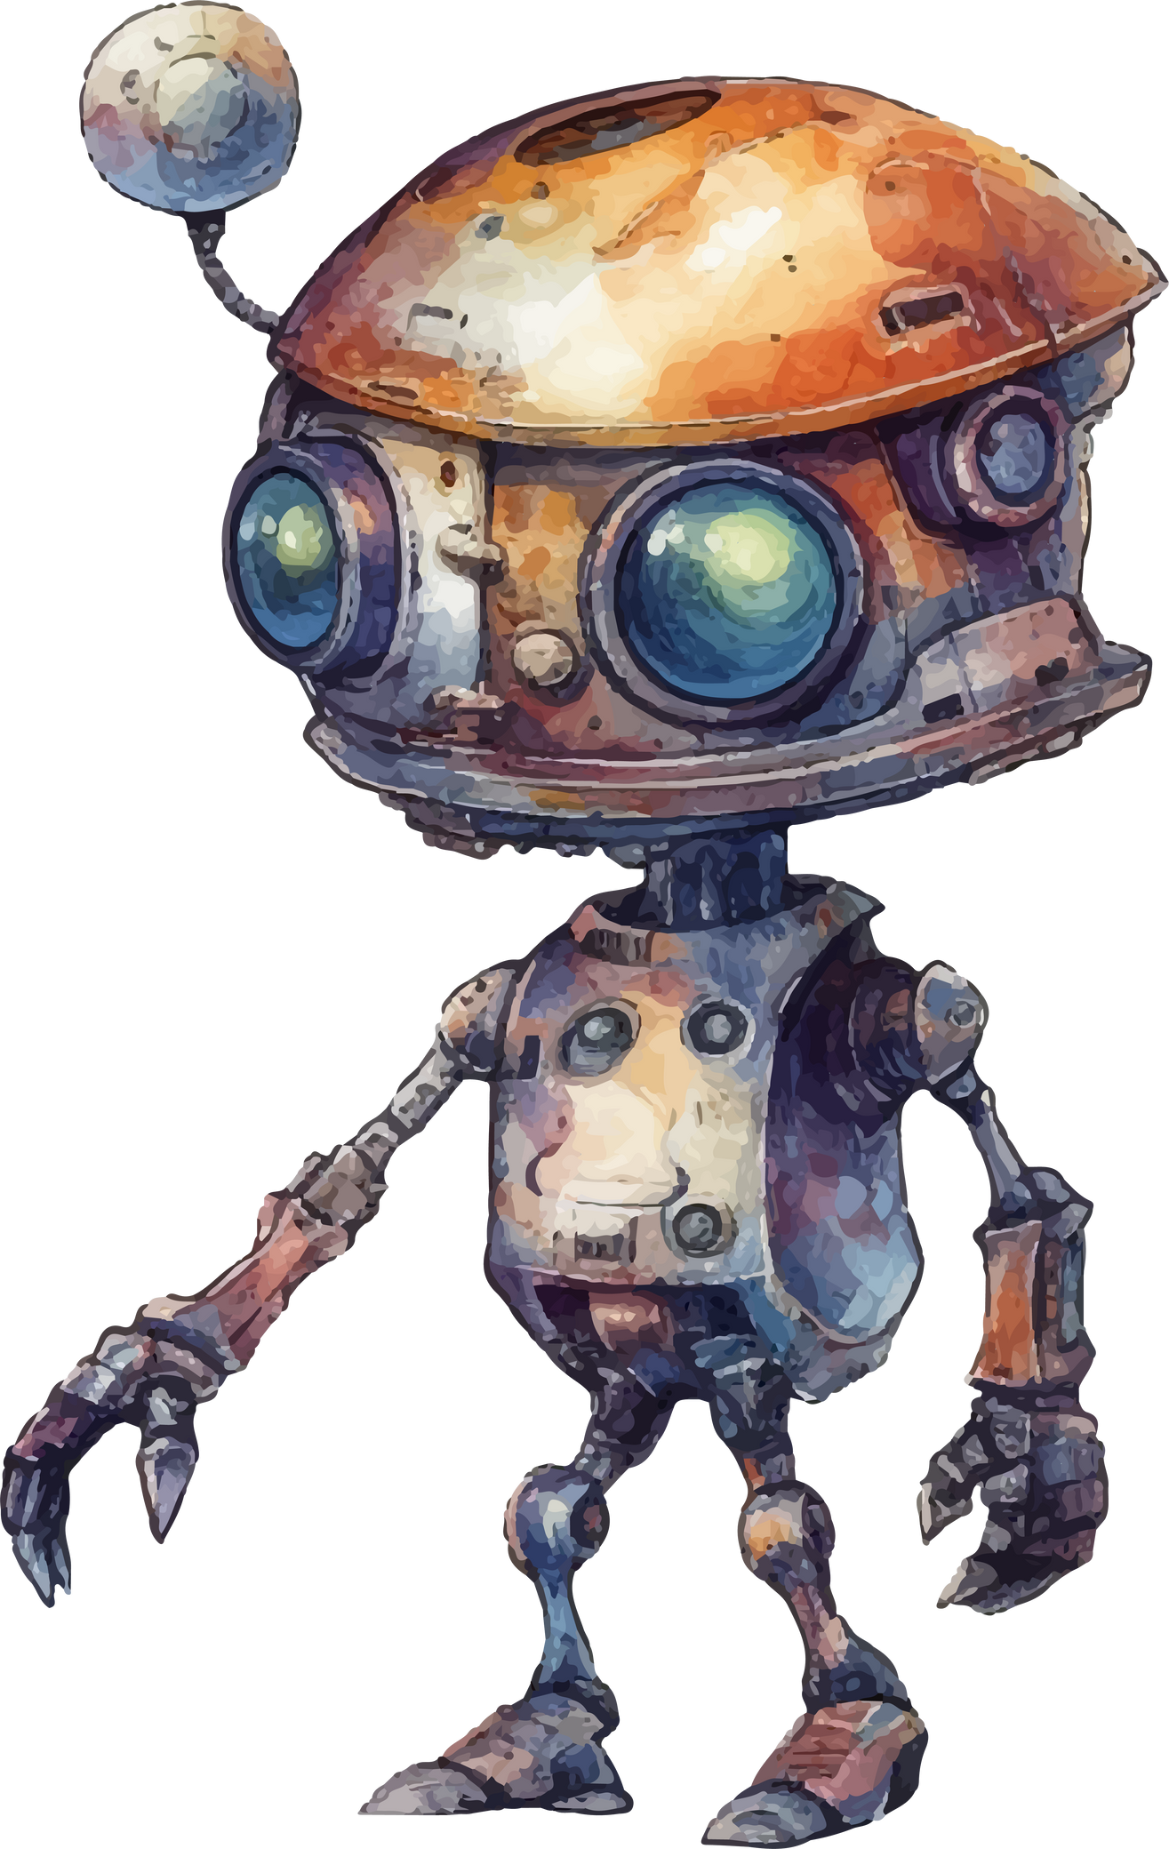
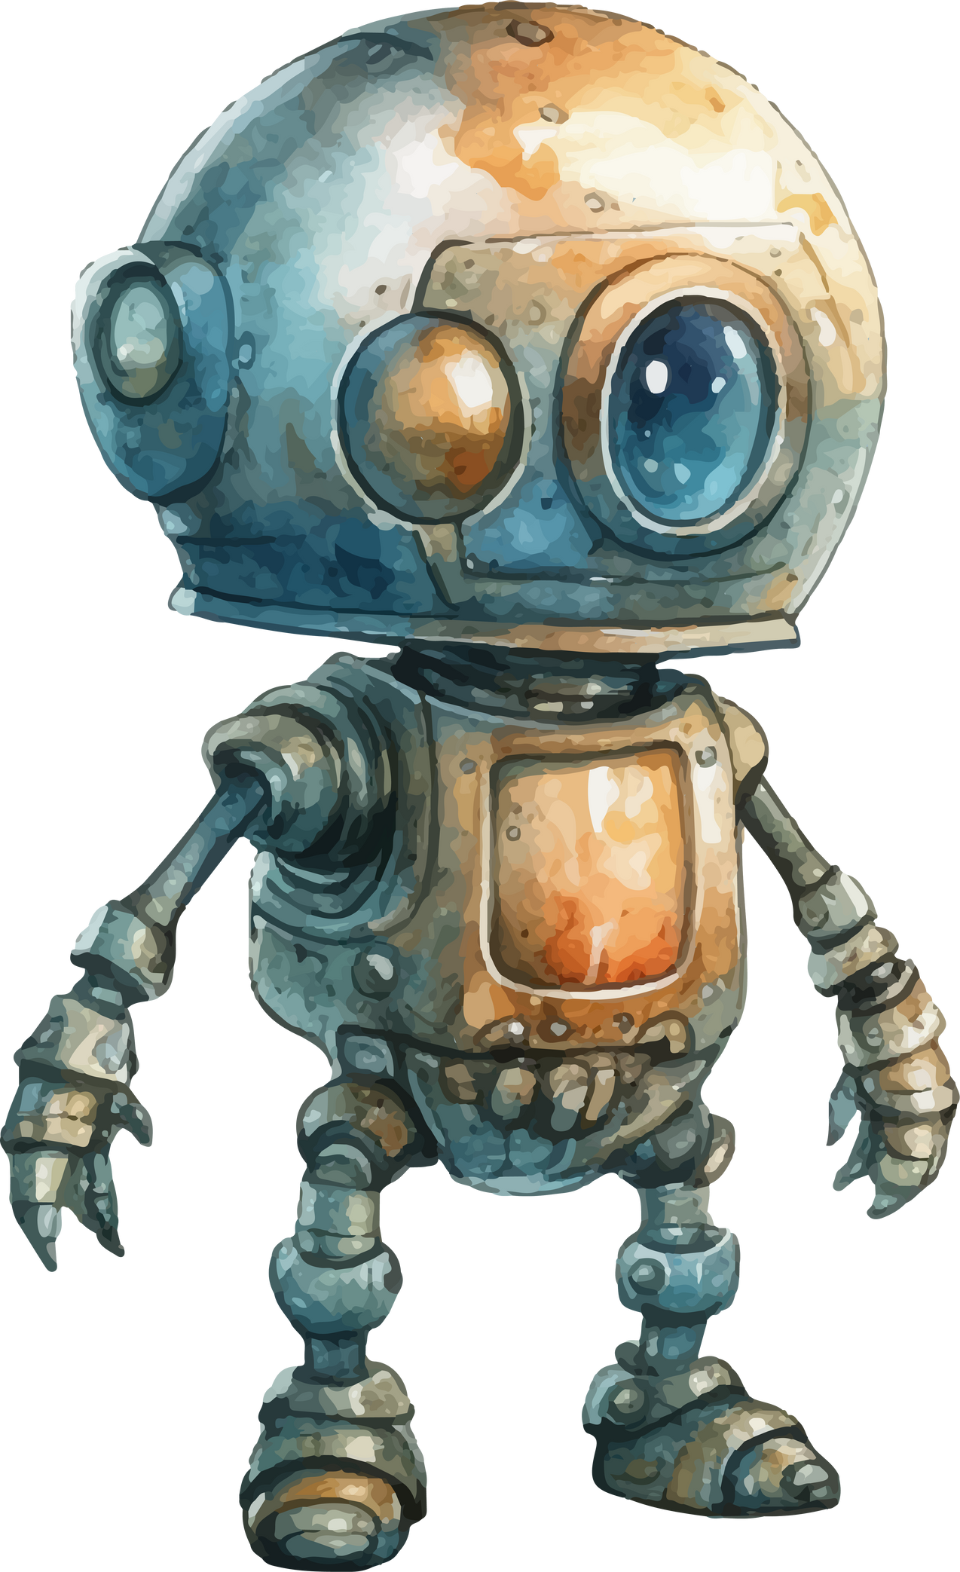
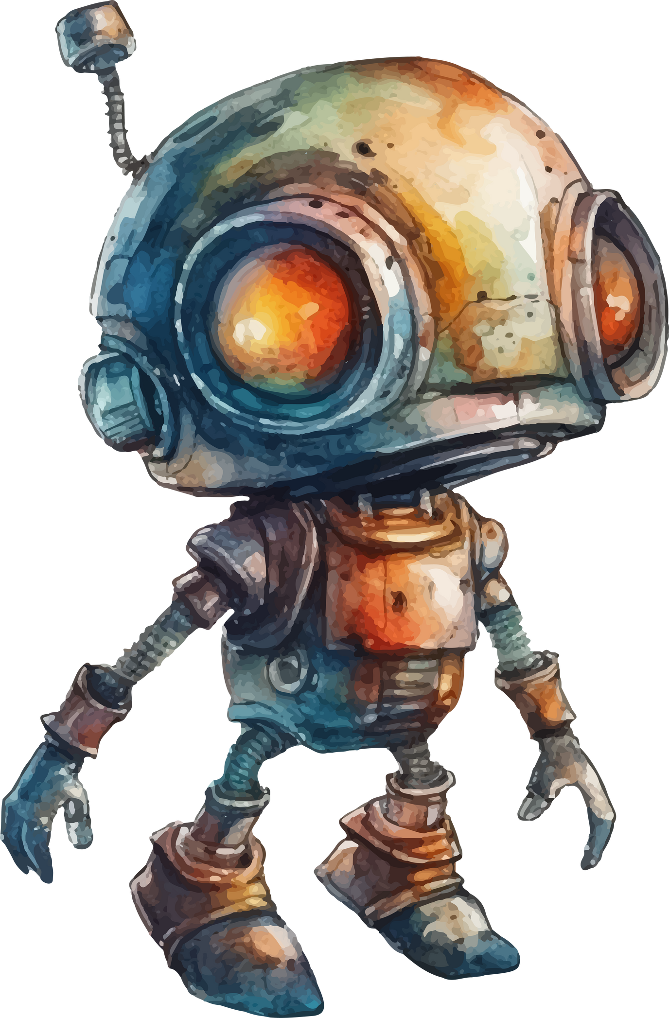

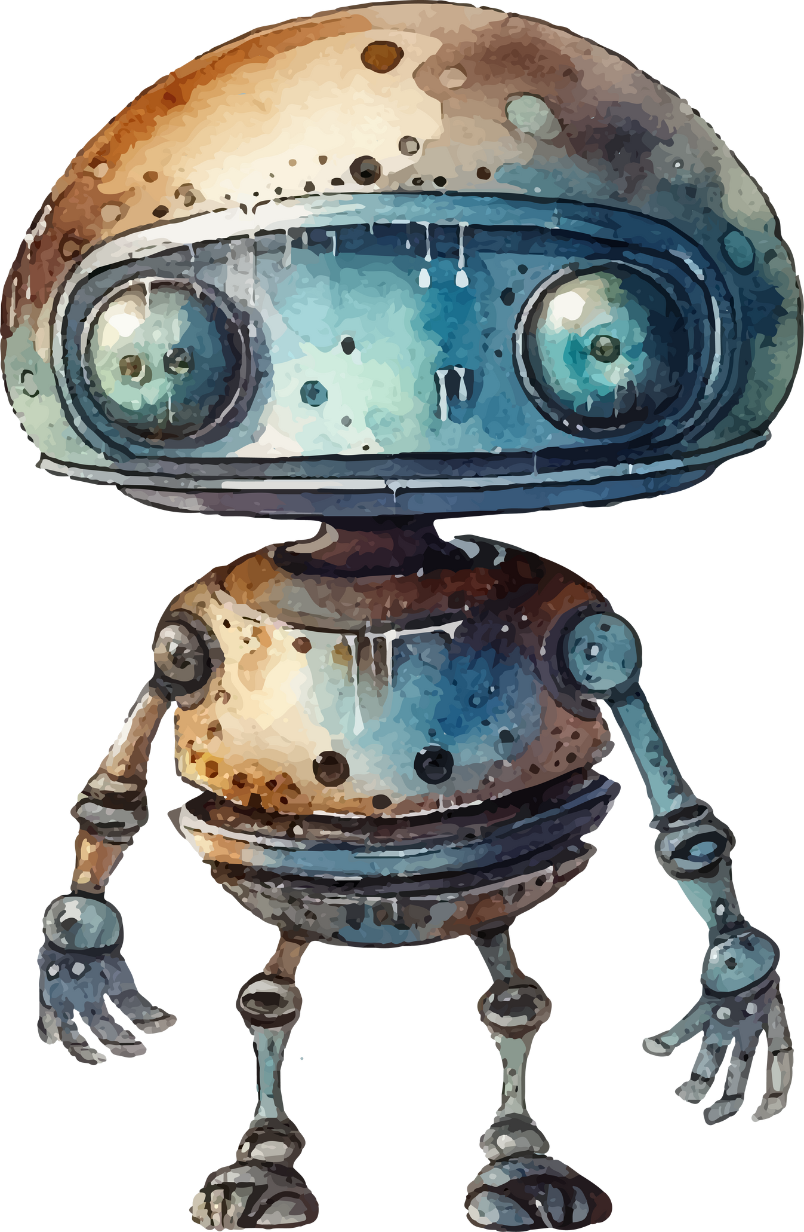

ROBOTICS
Case Study - Group 01

Slide 2

INTRODUCTION TO AI ROBOTICS
Analytical approach of the Inverse Kinematics solutions of 6-DOF Industrial Robots.
- A detailed case study

Slide 3

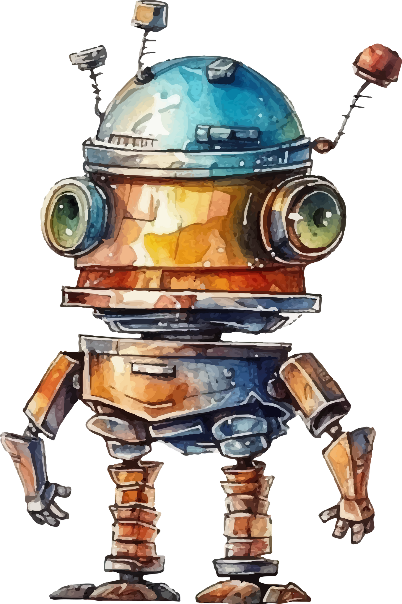
TEAM MEMBERS
Aniketh Vijesh
Girish S
V Hemanth Kumar
AIE22009
AIE22044
AIE22053
-
-
-

Slide 4

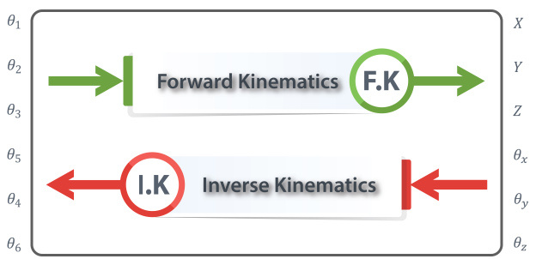
WHAT IS INVERSE KINEMATICS?
Inverse kinematics refers to process of obtaining joint angles from known coordinates of end effector
Notes:
Robot kinematics deals with the motion intricacies of robots, including converting between cartesian and joint spaces. It involves two key problems: forward kinematics, which determines the end effector's position and orientation based on joint angles by solving forward kinematics equations, and inverse kinematics, which finds the joint angles needed to achieve a desired end effector position and orientation in a reference frame.

Slide 5

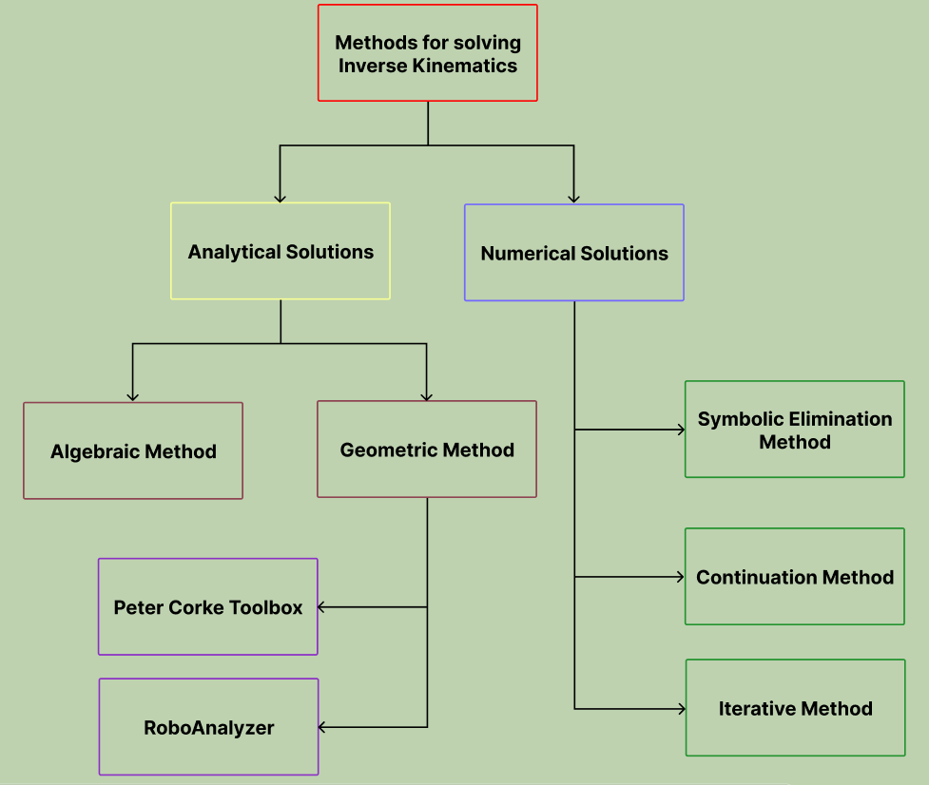
METHODS FOR SOLVING INVERSE KINEMATICS
Various methods such as analytical, numerical and machine learning based algorithms

Slide 6

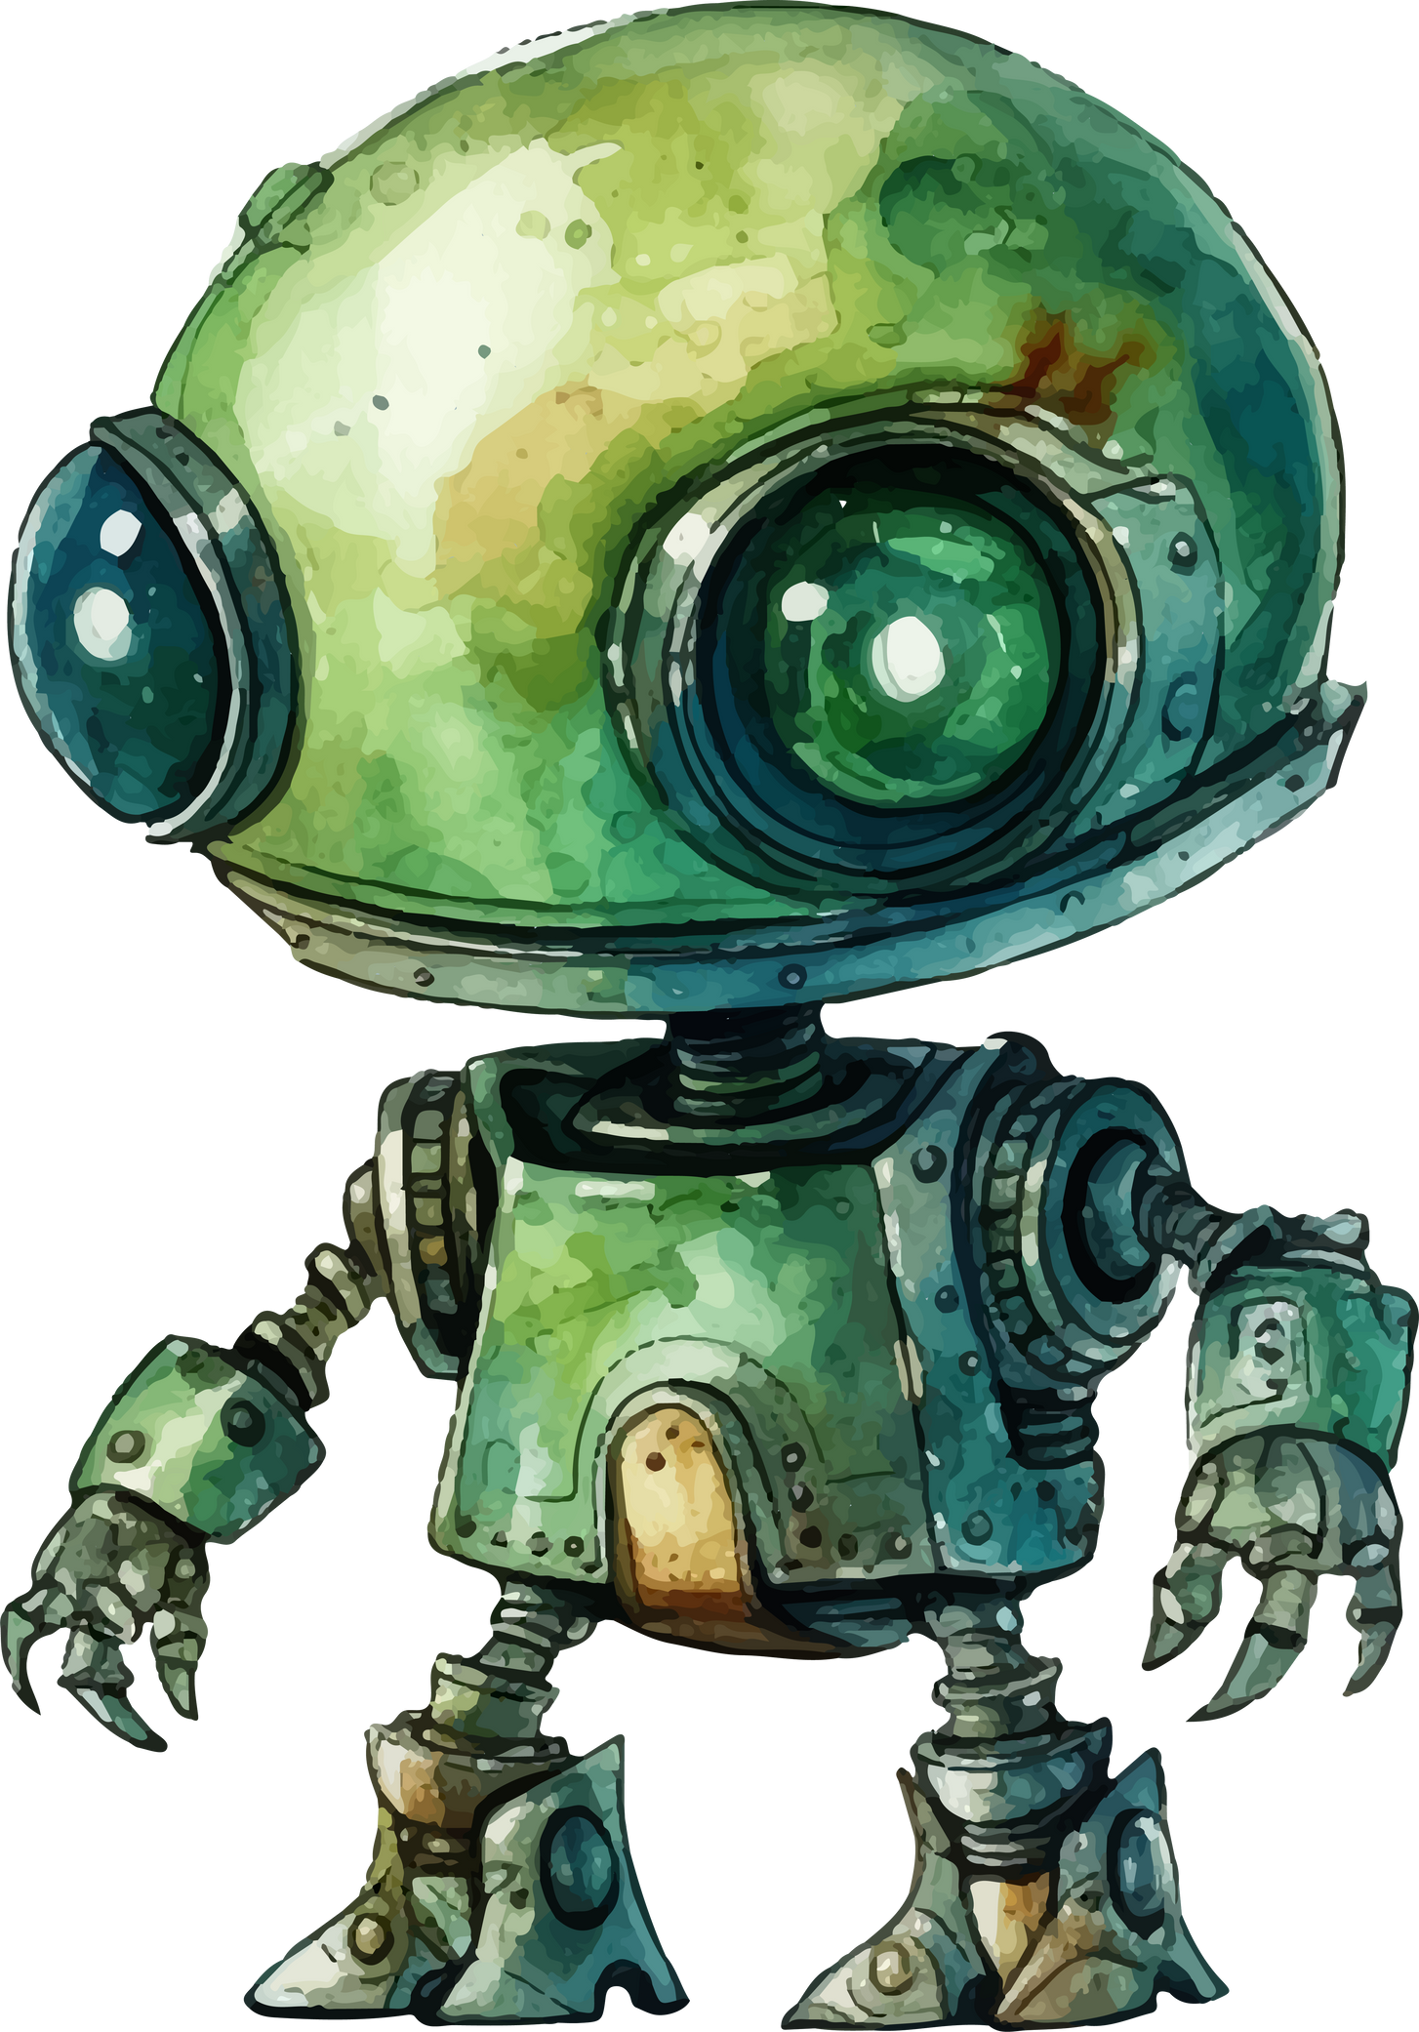
ANALYTICAL METHOD FOR SOLVING INVERSE KINEMATICS
Analytical methods involve solving kinematic equations to find joint angles. These methods are precise and provide a closed-form solution, but they can be complex and computationally intensive. Common analytical methods include the Denavit-Hartenberg (D-H) parameters and the Jacobian matrix.

Slide 7
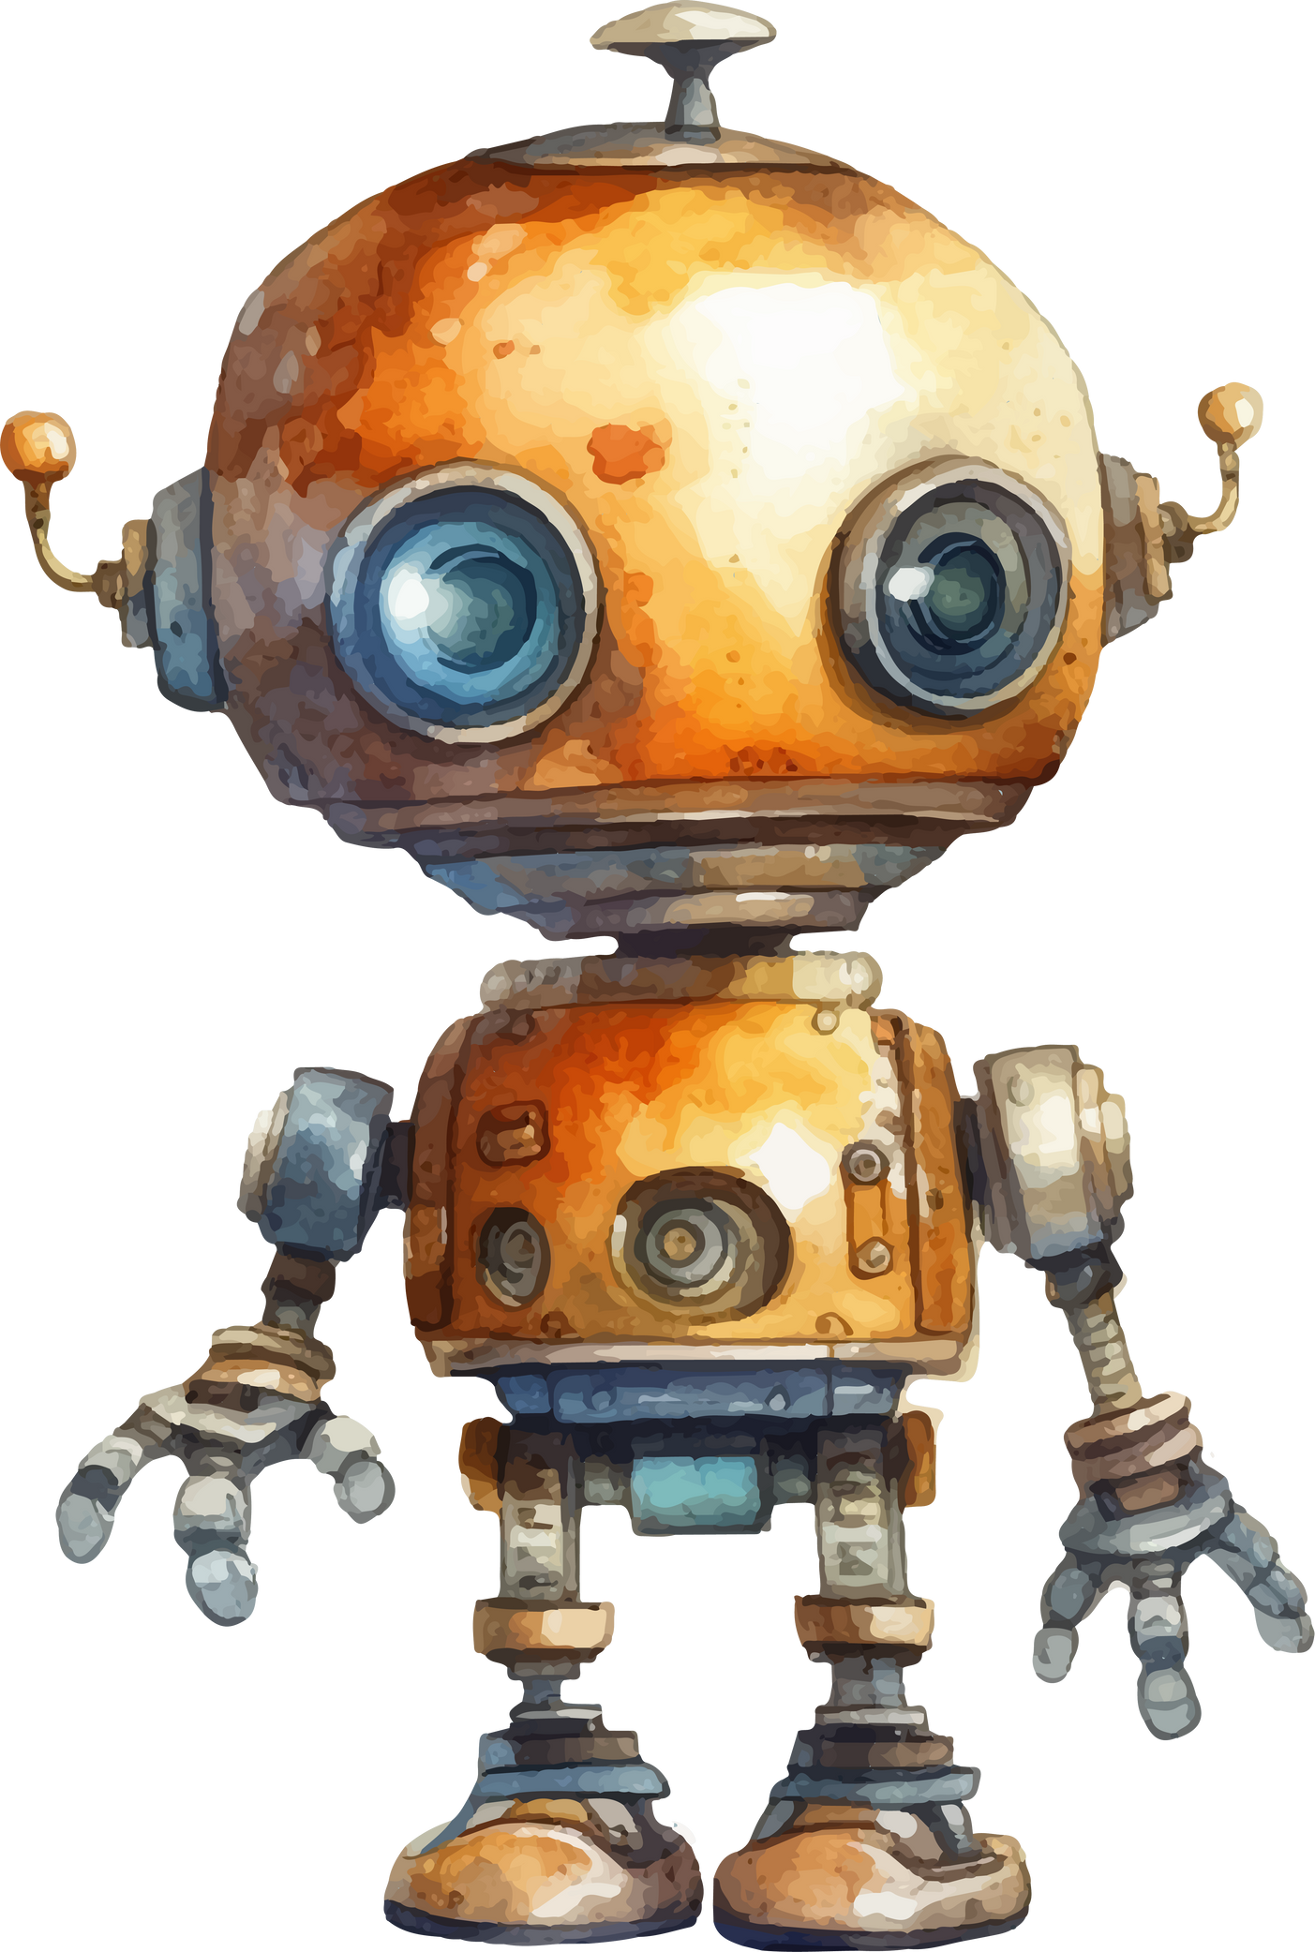
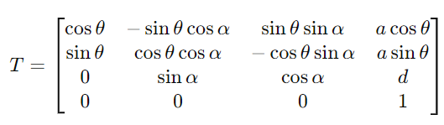

DENAVIT-HARTENBERG (D-H) PARAMETERS :
The D-H method is widely used for simplifying the kinematic equations of robot arms. It describes the spatial relationship between successive link coordinate frames using four parameters: link length, link twist, link offset, and joint angle. This method is crucial for forward and inverse kinematics solutions.
Notes:
This systematic method, illustrated below, assigns a coordinate frame to each joint and uses these parameters to create transformation matrices, facilitating the analysis and control of robotic systems.

Slide 8


THE JACOBIAN MATRIX
The Jacobian matrix method is used for calculating the relationship between joint velocities and end-effector velocities. It is particularly useful in inverse kinematics for finding joint configurations that achieve a desired end-effector position and orientation.

Slide 9
PETER CORKE’S ROBOTICS TOOLBOX
Peter Corke’s robotics toolbox is an open-source toolbox for robotic systems. This toolbox contains a collection of functions and tools for robotic systems that allow users to easily implement and test robot control and vision algorithms
Notes:
The
toolbox provides users with the ability to quickly and easily design, program, and stimulate robotic
systems

Slide 10

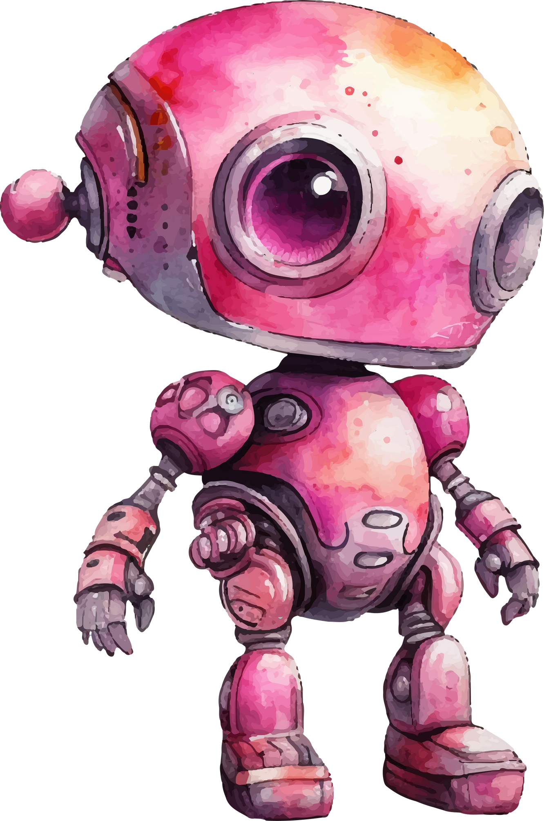
ROBOANALYZER
Roboanalyzer is a 3D model-based solution with multiple modules that may be used to efficiently visualize different robotics topics. It can display D-H parameter animation and conduct forward and inverse kinematics, as well as dynamic analyses of serial robots

Slide 11

SOLUTION FOR INVERSE KINEMATICS
Inverse kinematics is more complicated than forward kinematics. Inverse kinematics is essential for trajectory planning and motion control, whereas forward kinematics determines the pose of the end effector.
Various methods, such as geometric and algebraic analysis, are used to solve inverse kinematics based on the manipulator's structure.
In inverse kinematics, for any given location and orientation, the joint angles θ1, θ2, θ3, θ4, θ5, and θ6 can be calculated.
Notes:
The KUKA KR 22 R1610-2 industrial manipulator is a specific model of robot produced by KUKA.
It was chosen as an illustrative case study due to the unique characteristics that make it ideal for
kinematic analysis. It has six degrees of freedom (6-DOF) with a spherical wrist, which allows for a
wide range of motion and a high level of flexibility. This makes it an ideal subject for studying the
kinematics of a robot with a high degree of complexity [4]. Compared to other robots, the KUKA KR
22 R1610-2 is a compact robot with a high payload capacity and reach, making it suitable for a wide
range of applications, especially in small to medium-sized manufacturing

Slide 12
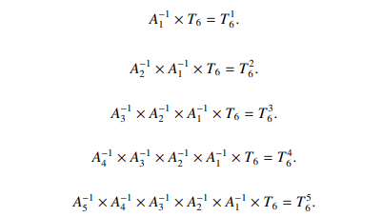
CALCULATING THE JOINT ANGLES
These equations sequentially multiply the transformation matrix by the inverse of individual transformation matrices.
This step-by-step multiplication helps isolate the individual joint transformations, making it easier to solve for each joint angle.
Notes:
The KUKA KR 22 R1610-2 industrial manipulator is a specific model of robot produced by KUKA.
It was chosen as an illustrative case study due to the unique characteristics that make it ideal for
kinematic analysis. It has six degrees of freedom (6-DOF) with a spherical wrist, which allows for a
wide range of motion and a high level of flexibility. This makes it an ideal subject for studying the
kinematics of a robot with a high degree of complexity [4]. Compared to other robots, the KUKA KR
22 R1610-2 is a compact robot with a high payload capacity and reach, making it suitable for a wide
range of applications, especially in small to medium-sized manufacturing

Slide 13
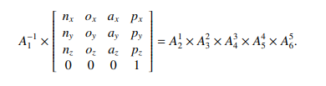
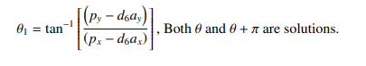
CALCULATING THE JOINT ANGLES
Multiplies the overall transformation matrix T6​ by the inverse of A1​ on both sides to start isolating the terms involving the joint angles.
These equations solve for the first joint angle theta1. By equating specific elements (like R33R_{33}R33​ and R34R_{34}R34​) of the resulting matrices from above the joint angle theta1​ is isolated and solved using trigonometric identities.
Notes:
The KUKA KR 22 R1610-2 industrial manipulator is a specific model of robot produced by KUKA.
It was chosen as an illustrative case study due to the unique characteristics that make it ideal for
kinematic analysis. It has six degrees of freedom (6-DOF) with a spherical wrist, which allows for a
wide range of motion and a high level of flexibility. This makes it an ideal subject for studying the
kinematics of a robot with a high degree of complexity [4]. Compared to other robots, the KUKA KR
22 R1610-2 is a compact robot with a high payload capacity and reach, making it suitable for a wide
range of applications, especially in small to medium-sized manufacturing

Slide 14
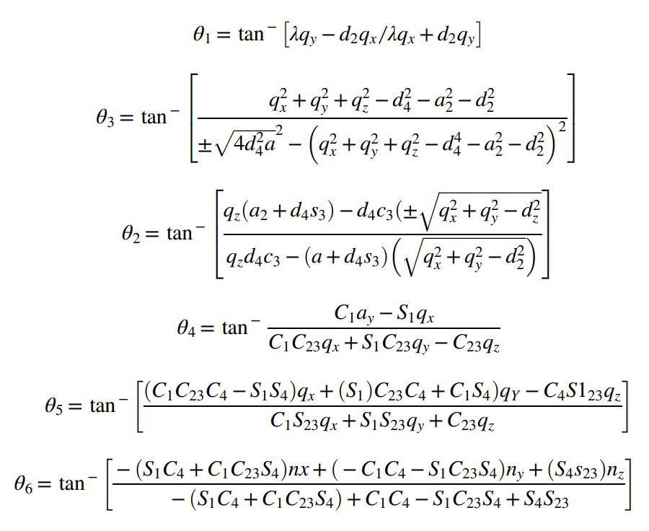
CALCULATING THE JOINT ANGLES
All the joint angles may be caluclated using these simplified forumlae as well.
Notes:
The KUKA KR 22 R1610-2 industrial manipulator is a specific model of robot produced by KUKA.
It was chosen as an illustrative case study due to the unique characteristics that make it ideal for
kinematic analysis. It has six degrees of freedom (6-DOF) with a spherical wrist, which allows for a
wide range of motion and a high level of flexibility. This makes it an ideal subject for studying the
kinematics of a robot with a high degree of complexity [4]. Compared to other robots, the KUKA KR
22 R1610-2 is a compact robot with a high payload capacity and reach, making it suitable for a wide
range of applications, especially in small to medium-sized manufacturing

Slide 15
KUKA KR 22 R1610-2
The KUKA KR 22 R1610-2 industrial manipulator is chosen as a case study for its unique characteristics, ideal for kinematic analysis.
With six degrees of freedom (6-DOF) and a spherical wrist, it offers extensive motion range and flexibility.
Compact yet capable of high payloads and reach, it's well-suited for diverse applications, particularly in small to medium-sized manufacturing.
Notes:
The KUKA KR 22 R1610-2 industrial manipulator is a specific model of robot produced by KUKA.
It was chosen as an illustrative case study due to the unique characteristics that make it ideal for
kinematic analysis. It has six degrees of freedom (6-DOF) with a spherical wrist, which allows for a
wide range of motion and a high level of flexibility. This makes it an ideal subject for studying the
kinematics of a robot with a high degree of complexity [4]. Compared to other robots, the KUKA KR
22 R1610-2 is a compact robot with a high payload capacity and reach, making it suitable for a wide
range of applications, especially in small to medium-sized manufacturing

Slide 16
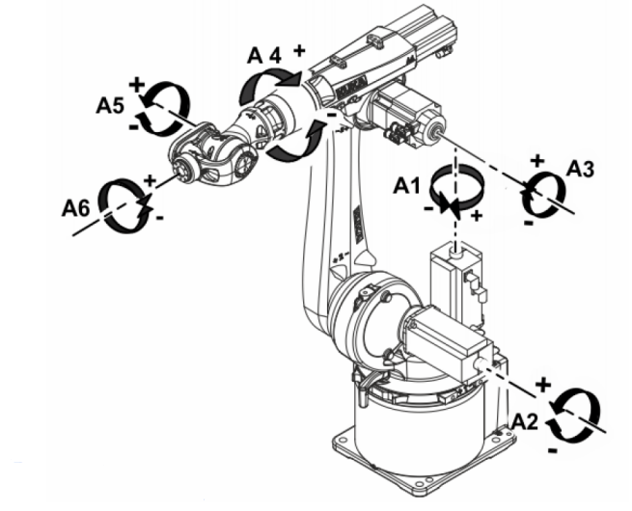
KUKA KR 22 R1610-2
the first three axes of the robot, A1, A2, and A3, are referred to as “major axes” because they are responsible for determining the end effector position, whereas the other three axes, A4, A5, and A6, are referred to as “minor axes” because they are used for describing the end effector to the specified position, and the minor axes contribute to end effector orientation
Notes:
The KUKA KR 22 R1610-2 industrial manipulator is a specific model of robot produced by KUKA.
It was chosen as an illustrative case study due to the unique characteristics that make it ideal for
kinematic analysis. It has six degrees of freedom (6-DOF) with a spherical wrist, which allows for a
wide range of motion and a high level of flexibility. This makes it an ideal subject for studying the
kinematics of a robot with a high degree of complexity [4]. Compared to other robots, the KUKA KR
22 R1610-2 is a compact robot with a high payload capacity and reach, making it suitable for a wide
range of applications, especially in small to medium-sized manufacturing

Slide 17
FANUC LR MATE 200ID
The FANUC LR Mate 200iD industrial manipulator is chosen as a case study for its unique characteristics, ideal for kinematic analysis.
With six degrees of freedom (6-DOF) and a compact design, it offers precise motion control and versatility.
Lightweight yet capable of handling various payloads and providing significant reach, it
is well-suited for a wide range of applications, particularly in small to medium-sized manufacturing and assembly processes.
Notes:
The KUKA KR 22 R1610-2 industrial manipulator is a specific model of robot produced by KUKA.
It was chosen as an illustrative case study due to the unique characteristics that make it ideal for
kinematic analysis. It has six degrees of freedom (6-DOF) with a spherical wrist, which allows for a
wide range of motion and a high level of flexibility. This makes it an ideal subject for studying the
kinematics of a robot with a high degree of complexity [4]. Compared to other robots, the KUKA KR
22 R1610-2 is a compact robot with a high payload capacity and reach, making it suitable for a wide
range of applications, especially in small to medium-sized manufacturing

Slide 18
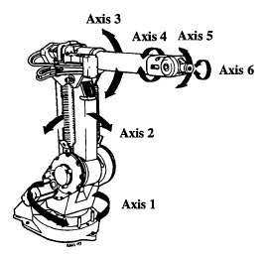
FANUC LR MATE 200ID
The first three axes of the FANUC LR Mate 200iD, J1, J2, and J3, are referred to as "major axes" because they are responsible for determining the end effector position, whereas the other three axes, J4, J5, and J6, are referred to as "minor axes" because they are used for describing the end effector's orientation. The minor axes contribute to positioning the end effector at the specified location with the desired orientation.
Notes:
The KUKA KR 22 R1610-2 industrial manipulator is a specific model of robot produced by KUKA.
It was chosen as an illustrative case study due to the unique characteristics that make it ideal for
kinematic analysis. It has six degrees of freedom (6-DOF) with a spherical wrist, which allows for a
wide range of motion and a high level of flexibility. This makes it an ideal subject for studying the
kinematics of a robot with a high degree of complexity [4]. Compared to other robots, the KUKA KR
22 R1610-2 is a compact robot with a high payload capacity and reach, making it suitable for a wide
range of applications, especially in small to medium-sized manufacturing

Slide 19
ABB IRB 1600
The ABB IRB 1600 industrial manipulator is chosen as a case study for its unique characteristics, ideal for kinematic analysis.
With six degrees of freedom (6-DOF) and a spherical wrist, it offers extensive motion range and flexibility.
Compact yet capable of handling high payloads and reach, it's well-suited for diverse applications, particularly in small to medium-sized manufacturing.
Notes:
The KUKA KR 22 R1610-2 industrial manipulator is a specific model of robot produced by KUKA.
It was chosen as an illustrative case study due to the unique characteristics that make it ideal for
kinematic analysis. It has six degrees of freedom (6-DOF) with a spherical wrist, which allows for a
wide range of motion and a high level of flexibility. This makes it an ideal subject for studying the
kinematics of a robot with a high degree of complexity [4]. Compared to other robots, the KUKA KR
22 R1610-2 is a compact robot with a high payload capacity and reach, making it suitable for a wide
range of applications, especially in small to medium-sized manufacturing

Slide 20
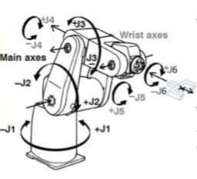
ABB IRB 1600
The first three axes of the ABB IRB 1600, A1, A2, and A3, are referred to as “major axes” because they are responsible for determining the end effector position, whereas the other three axes, A4, A5, and A6, are referred to as “minor axes” because they are used for orienting the end effector to the specified position. The minor axes contribute to end effector orientation.
Notes:
The KUKA KR 22 R1610-2 industrial manipulator is a specific model of robot produced by KUKA.
It was chosen as an illustrative case study due to the unique characteristics that make it ideal for
kinematic analysis. It has six degrees of freedom (6-DOF) with a spherical wrist, which allows for a
wide range of motion and a high level of flexibility. This makes it an ideal subject for studying the
kinematics of a robot with a high degree of complexity [4]. Compared to other robots, the KUKA KR
22 R1610-2 is a compact robot with a high payload capacity and reach, making it suitable for a wide
range of applications, especially in small to medium-sized manufacturing

Slide 21
CONCLUSION
In this presentation, we explored the analytical approaches to solving the inverse kinematics of 6-DOF industrial robots. We began by defining inverse kinematics and its significance in robotic systems. We then delved into the details of analytical methods, emphasizing their precision and computational efficiency. Key concepts such as the Denavit-Hartenberg parameters, closed-form solutions, and both algebraic and geometric methods were discussed.

Slide 22
THANK YOU
GIRISH S
V HEMANTH KUMAR
ANIKETH VIJESH
-
-
-
AIE22044
AIE22053
AIE22009

